Slide 1


HEART DISEASE PREDICTION
MENTOR:
DR. SURENDRA KUMAR SHUKLA
Made By:
AAMOLIKA

Slide 2
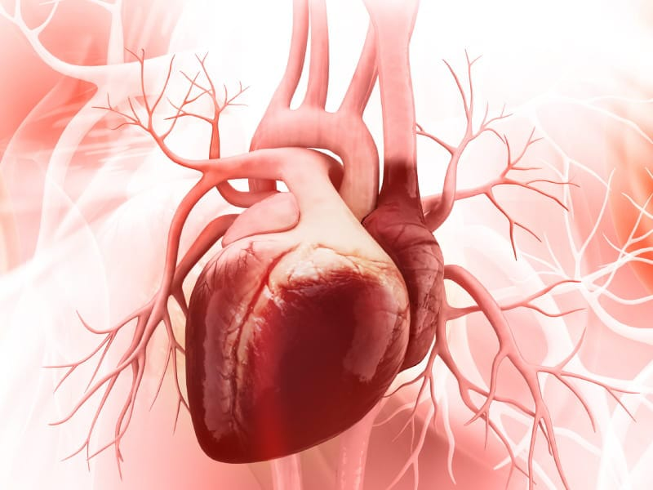
to
INTRODUCTION
Heart Disease Prediction
Heart sickness is a prime worldwide health problem, chargeable for a tremendous number of deaths internationally. Early detection and correct prediction of coronary heart disorder can significantly enhance patient consequences and reduce mortality rates. In latest years, device mastering techniques have proven promise in diverse scientific programs, including coronary heart disorder prediction. This task pursuits to increase a system gaining knowledge of model able to as it should be predicting the probability of coronary heart disorder based totally on a hard and fast of clinical and demographic functions. The proposed model can be educated on a comprehensive dataset comprising affected person facts and could leverage numerous category algorithms to obtain most excellent overall performance. The outcomes acquired from this examine have the capacity to assist healthcare carriers in figuring out high-hazard individuals and implementing well timed interventions to save you heart ailment development and related headaches, this project is made using the dataset of people and their important features, which will help the model to predict whether or not a person has a heart disease or not,if yes then output will be 1, otherwise it’ll be 0.

Slide 3


Problem Statement
Design and develop a Heart Disease Prediction model using Machine Learning to automatically tell whether or not a person is suffering from a heart disease, it tells the output just with the help of some basic features provided by the user.

Slide 4

METHODOLOGY
•To start the project we are going to follow the Steps given below:
The very first step is to import the necessary libraries which are used in the code, which are pandas ,numpy ,sklearn, seaborn.
2. Now we are going to upload our dataset to our notebook.
3. After uploading the .csv file, we check if our data set has null or missing values.
4. Data is balanced, as it is essential for accurate results because by data balancing graph we
can see the difference between the count of the target classes ,the target classes where “0”
represents no heart disease patient and “1” represents heart disease patients

Slide 5
5. Before creating the prediction model ,we will first of all separate features from the target.
To start with the predication, the system has to collect the data and then decide about the training
and testing data. In this project we have used 70% for training from the dataset and
30%data from the dataset is used for testing the data in the system.
6. Now we start with the algorithms, we apply different machine learning algorithms, like
logistics regression, support vector algorithm, random forest, decision tree classifier.
7. On the basis of the accuracy score we take the model of logistic regression, which helps
predict whether or not a person has heart disease or not.
8. Then we predict the data as the features are provided by the user in input, we have finally
created a Heart Disease Predictor.
.

Slide 6
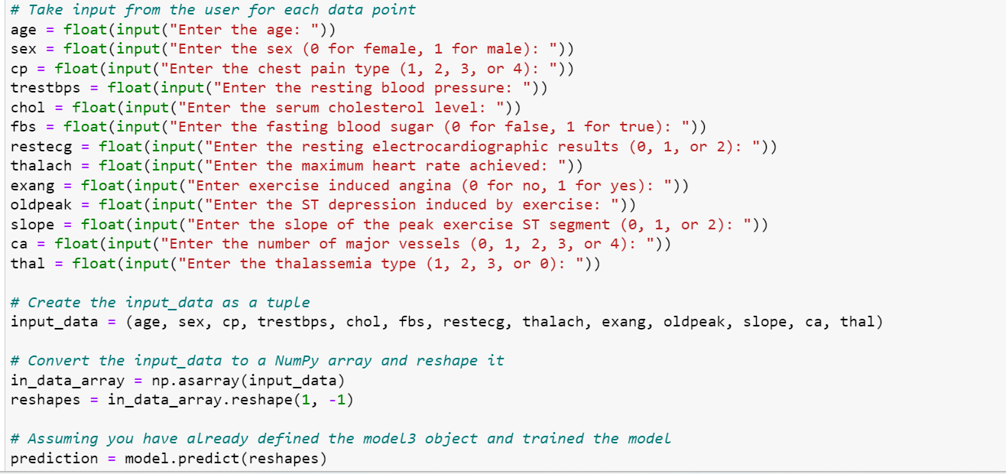
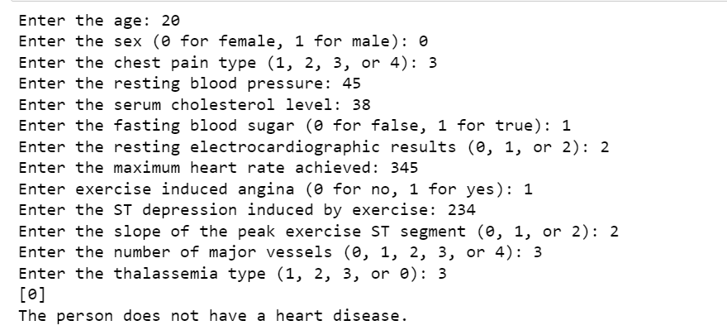
RESULT AND DISCUSSION
We have successfully built a Heart Disease Predictor model, using Logistic Regression
Algorithm. Which takes input in the form of integers or float from the user, about age, sex,
blood pressure, old peak, thal, etc. On the basis of these features it will help in prediction of 0
or 1,( WHICH WILL TELL US IF THE PERSON IS A HEART PATIENT OR NOT).
First of all the model will convert all features into integer and then create a matrix and solve
to find the target, and then declare yes or no.

Slide 7
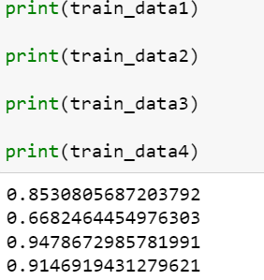
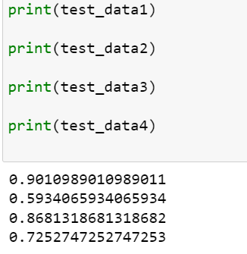

Slide 8
Conclusion and Future Work
In conclusion, the application of logistic regression to predict Heart disease provides a
valuable approach to identify individuals at risk and guide preventive interventions. By
leveraging, the model's interpretability, healthcare professionals can gain insights into the
importance and impact of various risk factors on the likelihood of cardiovascular disease.
Logistic regression provides, a transparent and intuitive framework that helps understand
associations between predictors and, disease outcome. Furthermore, logistic regression
integrates traditional and novel risk factors, enabling comprehensive assessment of
cardiovascular risk Inclusion of emerging predictors such as, genetic markers, lifestyle
choices, and socioeconomic factors, which furthermore expands the scope of risk assessment
and supports individualized approaches to preventive interventions.

Slide 9
Future Work:-
[1] Advanced feature engineering: Explore more sophisticated approaches to feature engineering, including interaction terms, polynomials, and feature selection algorithms This can help identify and add nonlinear relationships and interactions among predictors, thus increasing the predictive performance of logistic regression models.
[2] Dealing with missing data: Robust strategies for handling missing data in the context of cardiovascular prognosis. Imputation techniques, such as multiple imputation or advanced machine learning algorithms, can be used to efficiently handle missing values and reduce the potential bias in predictions .
[3] Dealing with imbalanced data: Address the issue of class imbalance in cardiovascular data using oversampling, undersampling, or hybrid techniques such as SMOTE (Synthetic Minority Over-sampling Technique). These techniques can help reduce the impact of information imbalances and improve the model’s ability to accurately predict cardiovascular disease.

Slide 10
Thanks

